Slide 1

Rent Smart:
Financial Tips
for Off-Campus Living
Presenters:
Tom Jara | Business Development Officer VP, UBT at UNL
Brittany Planos, MBA, M.Ed., AFC® | Financial Literacy Program Senior Manager

Slide 2
Disclosure
Union Bank & Trust’s Financial Literacy materials, articles, guides, blogs, podcasts, and videos are for informational purposes only and not an advertisement for a product or service. The accuracy and completeness is not guaranteed and does not constitute legal or tax advice. Please consult with your own tax, legal, and financial advisors. Member FDIC.

Slide 3
Welcome to the University —
we are happy you are here!
Notes:
My name is Brittany Planos. I am the financial educator for Union Bank & Trust. We support Nebraska students with opening bank accounts, managing their finances and connecting you to resources on campus and within Lincoln.

Slide 4
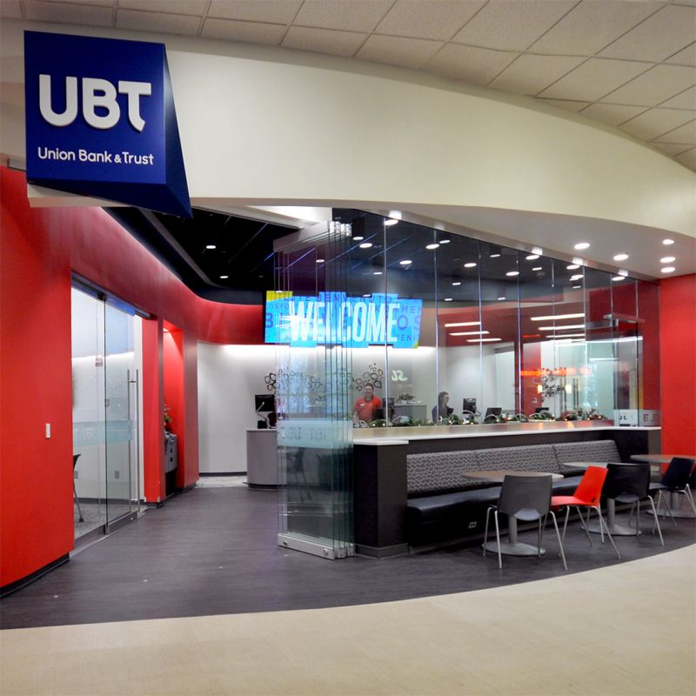
Union Bank & Trust (UBT)
UBT is the official banking partner of the University
Located inside the City Campus Student Union
Additional locations across Lincoln
UBT offers exclusive banking services for UNL students and staff, including:
  Checking (“current” or “transaction”) accounts
  Savings accounts
  Lending services
  Credit cards

Slide 5

Quick facts about Lincoln, Nebraska
Second largest city in Nebraska with approx. 300,000 people
Center of the state’s governmental and educational activities, including UNL
Housing is about 17% lower in Lincoln than the U.S. national average
“Four-season” climate
Notes:
Lincoln is also a national resettlement community for immigrants and refugees. The median age of residents is 33 years old and 40% of adults hold a bachelor’s degree.

Slide 6
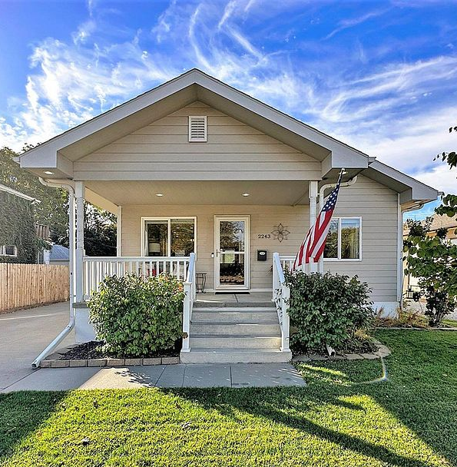
Common off-campus student housing types
Apartments
  Standard
  Student-living apartments
    Unaffiliated with University Housing, but located near campus
    Provide student-friendly amenities
    May come fully or partially furnished
    Generally, more expensive than standard apartments
Houses
Detached or “single-family” homes
  A single home may be converted into two or more housing units, such as a duplex
Notes:
Lincoln was largely settled in the late 1800’s and early 1900’s. Housing stock near campus often is reflective of the period with many single-family American Craftsman-style homes and bungalows with newer student living high-rise apartments in downtown and in Lincoln’s adjacent historic Haymarket District.

Slide 7
Off-campus housing considerations

Slide 8
Determining your housing needs
A helpful place to start your search is by making a list of your housing needs:
  Do I need a roommate to share costs, or can I afford to live alone?
  What length of rental period do I need? (12 months is most common)
  How many bedrooms do I need?
  Are appliances/furnishings included?
  Where will I be taking most of my classes/spending my time?
  How close do I need to be to campus or a StarTran bus route?
  What is the proximity to primary/secondary schools? (for students bringing children)
  What amenities/services are included?

Slide 9
Determine the rental price you can afford before starting your housing search

Slide 10
How much rent can I afford?
To maintain financial stability, it is recommended your monthly rent be less than 30% of your gross monthly income (before taxes and deductions).
Example:
Graduate stipend = $1,500 USD per month
Rent should be no more than $450 USD
Notes:
Housing rental prices depend on the type of property, size, and location
Single-family detached homes tend to be more expensive than apartments. However, they provide more space and when shared with roommates, may be more cost efficient.
Apartments vary greatly in price depending on size, proximity to campus, and amenities (fitness center, parking garages, etc.)
This will ensure you have enough money for food, transportation, utilities, and other necessities each month.

Slide 11
Monthly expense scenario
Monthly Expense Example: Starting Balance $1,500 | Average Amount (USD)
Rent | ($450)
Renter’s insurance | ($15)
Auto payment | ($360)
Auto insurance | ($135)
UNL commuter student parking permit | ($45)
Gasoline | ($50)
Utilities (heat, electricity, internet) | ($160)
Groceries and food (outside of dining plan) | ($175)
Cell phone plan | ($100)
Ending Balance | $10
Typical monthly expenses can quickly reduce your income!
Let’s say your starting balance is a graduate stipend of $1,500 USD per month. After expenses, you would have only $10 left over in this scenario.
Notes:
Of course, each student’s situation and expenses are unique, but what we hope to convey is that if you spend too much on rent, you won’t have money for other things you may need or to enjoy yourself while you’re living in Lincoln.
Housing rental prices depend on the type of property, size, and location
Single-family detached homes tend to be more expensive than apartments. However, they provide more space and when shared with roommates, may be more cost efficient.
Apartments vary greatly in price depending on size, proximity to campus, and amenities (fitness center, parking garages, etc.)

Slide 12

Roommates can help with cost sharing
Average monthly rent prices in Lincoln:
  Studio: $ 963
  1 bd: $ 1,063
  2 bd: $ 1,315
  3 bd: $ 1,611
Roommates can help share costs of:
Utilities, internet, streaming services
Groceries
Household supplies
Notes:
Many university students choose to live with roommates off-campus to help share the cost of living.

Slide 13
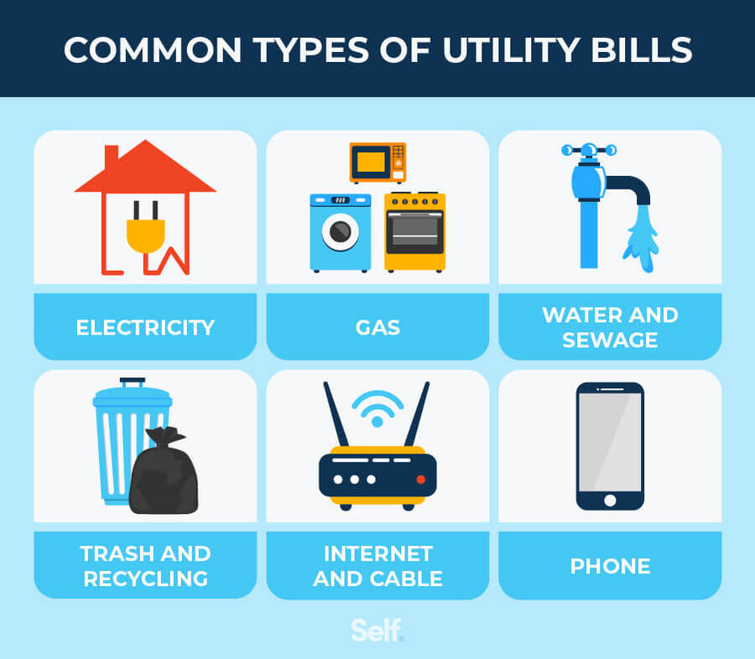
Additional expenses: Utility services
Most renters are required to pay for utility services separately from their monthly rent.
It is important to ask which, if any, may be included with the rent.
The property owner will provide instructions for how to set up service with the provider:
  Electricity: Lincoln Electric System
  Natural Gas (heat): Black Hills Energy
  Water/wastewater: Lincoln Water System
  Internet (various providers): Ex. ALLO
Notes:
All Lincoln residents use Lincoln Electric System, Black Hills Energy, and Lincoln Water System
The property owner or landlord usually pays for garbage/waste removal, water service, snow removal, and landscaping maintenance
Lincoln residents have choices for garbage/recycling and internet/television service providers

Slide 14

Additional expense: furnishings
Aside from student-living apartments, most off-campus housing does not come furnished. The following items are typically included in the rent, however:
  Kitchen/bathroom cabinetry
  Refrigerator
  Microwave oven
  Full stove/range
  Dishwasher
  Heating, ventilation, and air conditioning (HVAC)
  Laundry (sometimes in unit or on site)
    This is important!
Notes:
Americans generally take their furniture with them when they move. Typically, when you first move into an apartment or house, the only things you will have are cabinetry, lighting fixtures, and some major appliances. Student-living accommodations may include these along with a bed, sofa, desk, dining tables and chairs.
Clothes lines are uncommon in the U.S. Most apartments will have laundry machines on site or within your unit, but not all do. If you do not have a car, going to a laundromat can be an inconvenience. There aren’t many near campus and you don’t want to be walking or taking the bus in cold winter weather or hot summer heat to a laundromat. Further, air drying clothes outside can be a challenge due to our weather.

Slide 15
Additional expense: security deposit
A security deposit is a sum of money given by you to your landlord at the beginning of your lease. The purpose is to protect the landlord against damages above normal wear and tear during tenancy.
Your security deposit is held by the landlord during your lease and can be returned to you, in part or in full, upon moving out assuming the apartment is returned in the condition outlined in your lease agreement.
Amount: Nebraska law limits the security deposit to an amount equal to one month’s rent.
Note: Pets and parking may require an additional fee.
Notes:
Source: Community Action Partnership of Lancaster and Saunders Counties Security Deposits : Security Deposits : Tenants' Rights : For Tenants : Tenant Support Services : Community Action (tenantservices.org)

Slide 16
Location, location, location

Slide 17

Where should I live?
The University of Nebraska has three Lincoln campuses. It’s important to know where most of your classes will be and where you will spend most of your time:
City (main) Campus
East Campus
Innovation Campus
Notes:
Housing closest to campus is convenient and often walkable but will be more expensive and is generally further away from grocery stores and shopping centers.

Slide 18
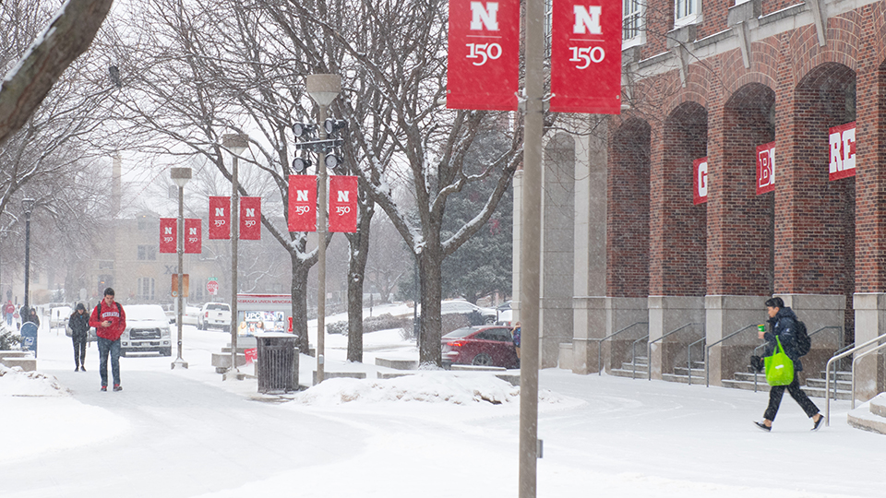
Remember, Nebraska has a four-season climate!
University students will experience Nebraska’s hot, humid summers and cold, snowy winters.
Nebraska’s often unpredictable weather can impact both your comfort and your commute to campus — be aware of distances!
You may need a car, bike, or public bus pass depending on where you choose to live within the city.
Buses generally run daily among the University’s campuses every 10-20 minutes.

Slide 19
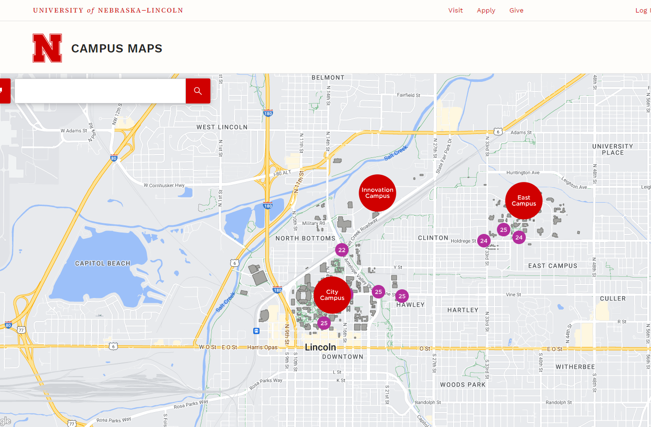
Distances between Nebraska campuses
2.5 mi (4.02 km)
1.1mi (1.77 km)
2.5 mi (4.02 km)

Slide 20
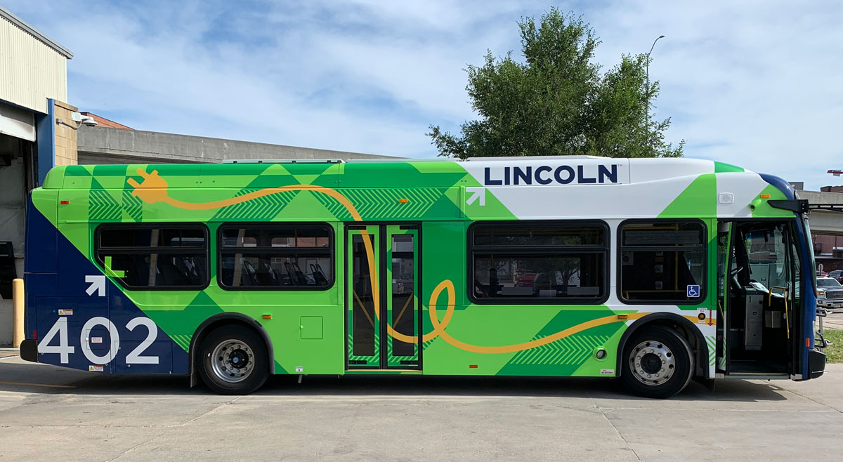
Travel considerations
Distance from campus: Housing closer to the University may be more convenient but also more expensive.
Public transportation: StarTran is the only mass transit carrier for the City of Lincoln. If you choose to live further from the University and do not have a car, you will want to live close to the StarTran route.
Bicycle trails: Lincoln has an extensive bicycle trail network that covers over 130 miles connecting commuters to campus.
  Community bicycles can be rented through BikeLNK.
Notes:
Distance from campus

Slide 21
Searching for housing

Slide 22

The housing search process
Start your search early, ideally during the summer before you arrive
Contact available properties
    Request virtual tours, if available
    Compare and ask questions
Complete a rental application
Sign your lease agreement
Pay security deposit and first month’s rent and monthly rent thereafter
Give the required notice when ready to vacate the property as outlined in your lease agreement

Slide 23
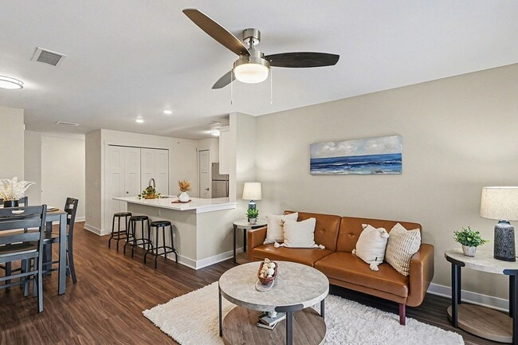
Where to search for housing
There is no singular database for searching for housing. Many search tools are available, but it’s important to be careful as unfortunately, housing scams widely exist. Helpful property search websites:
  Housr (official off-campus living app of UNL Housing & Dining)
  RentCafe.com
  Apartment Guide
  Apartment Finder
  Zillow
Review apartment property’s website, too
Get a feel for layout and pricing
Read online reviews from residents on Google
Review social media pages (Facebook, Instagram, etc.)

Slide 24

Avoiding potential housing scams
Never send money, wire transfers, or provide personal identification to someone you do not know
Scammers frequently steal legitimate listings to post fake advertisements, demanding upfront deposits for units that don’t exist

Slide 25
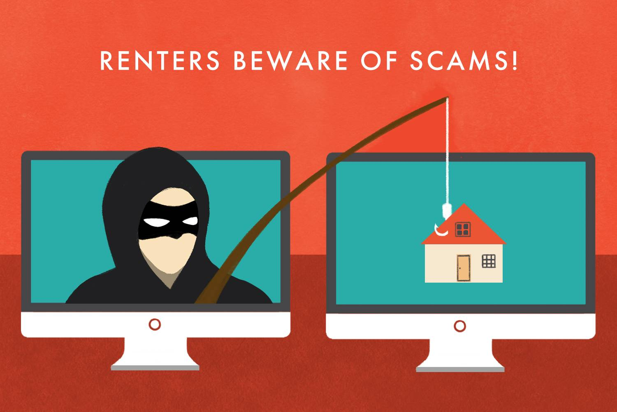
Avoiding potential housing scams, cont’d.
Verify the property
Tour the unit
Validate the property owner
Use secure payments: Pay fees and deposits through established secure methods:
  Credit cards, checks, bank ACH transfers which offer a trail and protection
  Never pay with cash, wire transfers, cryptocurrency or gift cards
Be aware of things that seem suspicious “red flags”

Slide 26
Touring available housing

Slide 27
Tour available housing
If possible, email the property office to set up a virtual tour
Try to schedule visits for the same day or weekend to help with comparison
Plan for 1 hour for each visit
Prepare a list of questions to ask
Ask if you can take pictures (this will help you remember later)
Take notes if the apartment will meet your needs

Slide 28

Questions to ask
May I view the unit I would actually live in? (this might be an option if there are no current tenants)
What is the rent amount?
When is rent due?
How do I pay rent (online, credit card, cash)?
Safety and security?
On-site management or maintenance?
Snow removal, lawn maintenance?
Modifications (can I plant flowers, paint, etc.)?
What utilities are my responsibility?

Slide 29
Submit rental application

Slide 30
Rental application
If you like a property, you can apply to rent (lease) it
There is usually a nonrefundable application fee (between $25-$100 USD is typical)
The property owner will usually ask for:
  Identification (passport)
  Proof of monthly income (such as teaching/research assistantship contract)
The application is used as a screening tool to:
  Assess your ability to pay rent
  Search potential criminal history
A property is not required to rent to you if you complete a rental application
Applying does not legally bind you to anything (but your lease agreement will)
Notes:
It is recommended to only submit rental applications for properties you are seriously considering as application fees are nonrefundable

Slide 31

Rental application overview
If your application to rent the apartment is approved, you have the option to sign a binding contract called a rental lease agreement to live there.
Rental lease agreements are usually valid for a term of 12 months.
Once the term ends, you usually have the option to renew the contract for the same term, or you may choose to vacate and find another option elsewhere.

Slide 32
Rental lease agreements

Slide 33
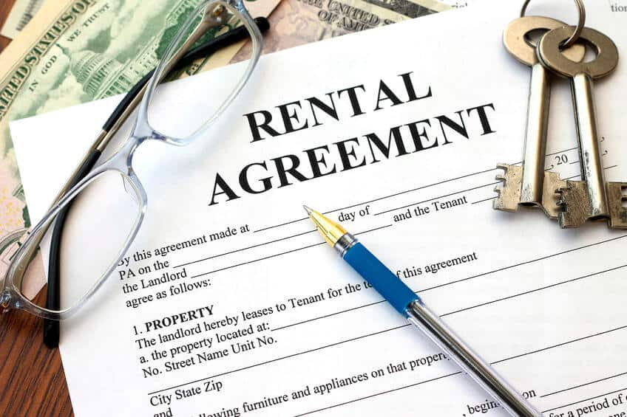
A rental (“lease”) agreement is a legal contract
Lease agreement
  Contract between you and the property owner/manager (“landlord”) that gives you the right to live at a property for a fixed, agreed-upon time in exchange for a monthly rental payment.
  If you do not like the property or wish to stay there any longer, you are legally responsible for paying the monthly rent until the lease expires unless you wish to pay extensive fees to terminate the agreement (often equivalent of 1 to 4 months’ rent, plus forfeiture of your security deposit)

Slide 34
Lease agreement contract inclusions
Term of lease (usually 12 months)
Rent amount and how to pay
Amount and conditions of security deposit
Conditions for renewing/ending lease
Paying for utilities
Property rules/regulations
Parking
Guest policies
Subleasing
Making alterations to property
How to request maintenance
Owning animals/pets
Any verbal agreements — get these in writing in the lease!
Notes:
A lease agreement outlines everything you need to know about living at the property. When disputes arise between a renter and a property owner, the provisions in the lease are usually what is enforceable vs. verbal agreements or discussions between you and the property owner.

Slide 35

Lease agreement
A lease agreement is a legally binding contract!
It is OK to ask questions and ask for reasonable changes to be made to the terms before you sign (requests need to be written in the lease to be enforceable)
Review the lease carefully before you sign it (but once you sign, you’re committed to the agreement)
  Read your lease thoroughly, you are responsible for everything in it!
  If there is something you do not understand, ask questions before you sign

Slide 36
Renter’s insurance
A landlord may require you to obtain a renter’s insurance policy prior to moving in
  (Cost: approx. $5-$15 USD per month)
Policy protects your personal belongings from loss or destruction due to:
  Fire
  Lightning
  Windstorm
  Hail
  Theft
  Vandalism
You can visit the National Association of Insurance Commissioners website to search for licensed consumer insurance companies.
Notes:
The amount of coverage you need depends on the types and cost of the property you own. It is encouraged to buy enough renter’s insurance to replace all of your personal possessions in the event of a loss such as your furniture, laptop, clothing, etc.
On average, renter’s insurance costs about $15 per month in Nebraska
UBT does not endorse any insurance company, but renter’s insurance can be purchased, and often online, through any reputable insurance agency (Examples: State Farm, Geico, Liberty Mutual, Allstate, Progressive, etc.).

Slide 37
Security deposit
Security deposit: A sum of money, usually equal to one month’s rent, due at the beginning of your lease.
Helps property owner pay for any damages incurred from tenants (carpet cleaning, nail holes, damage from pets or smoking, etc.)
Usually refundable when lease agreement ends if apartment is returned in good condition as outlined in the lease agreement
Note: Security deposit is a separate expense from the first month’s rent!

Slide 38
Complete a property unit “walk-through”

Slide 39
Completing a walk-through
A “walk-through” is the opportunity a property owner provides you to inspect your unit to establish its condition at the beginning of your lease to report any damages or problems prior to moving in.
Tips:
Take photos of each room and note any damages before you move in
Request updates or repairs be made if needed
Get a checklist for the end of the lease to make sure everything is in the condition they expect to help ensure your security deposit will be refunded to you
Request in writing any conditions in which your security deposit would not be refunded
  Ex: Damaged walls, dirty carpeting, etc.

Slide 40
Renting rights and responsibilities
Notes:
The U.S. has many laws which protect you as a tenant.

Slide 41
Know your rights as renter (“tenant”)
The U.S. has many laws that protect tenants. Basic tenant rights include the right to:
Freedom from discrimination
  For example, a property owner cannot refuse to rent to you based on your citizenship, age, gender, race, or ethnicity
Privacy
A healthy and safe living environment
Advance notice of eviction

Slide 42
Property owner (“landlord”) responsibilities
Keep the premises in a fit and habitable condition
Keep all common areas in a safe and clean condition
Maintain in good working order all electrical, plumbing, sanitary, heating, ventilation, and air conditioning
Provide running water, reasonable hot water, and reasonable heat
Provide receptacles for removing garbage and arrange for its removal
The property owner must deliver possession of the rental unit to you at the beginning of the lease term
Freedom from landlord retaliation (eviction, refusing to provide maintenance) for complaining to a housing agency for code violations
Freedom from unlawful entry (only with notice or an emergency is allowed)
Source: Tenant’s Rights: UNL College of Law

Slide 43
Your responsibilities as a renter
Follow the terms you agree to in your lease agreement
  Take reasonable steps to keep the property clean and sanitary
  No smoking or pets if not allowed
  No extra people living in the unit if they are not on the lease
    Follow property owner’s rules for guests
  Inform property owner if you plan to be away for an extended time
  Maintain renters’ insurance policy if required
  Pay the required rent until the end of the lease
  Promptly notify the landlord of any maintenance issues
  Notify the landlord when you plan to terminate your lease (usually require a written notice from you between 30-60 days before you plan to move out)
Notes:
It is important to follow the property owner’s rules for guests. If you have a spouse, partner, family member, friend or guest visiting beyond a few days, the property owner may determine that your guest is living with you which can be a violation of your lease.
If you plan to have a guest staying with you over academic breaks or the summer, it is important that you discuss this with the property owner before you sign your lease.
Similarly, if you plan to leave your apartment for an extended period of time, such as to return to your home country over the academic break, you need to inform the property owner. This should be outlined in your lease agreement. Unoccupied apartments can face damages such as frozen plumbing pipes in the winter. You may be responsible for any maintenance issues if you do not inform the property manager of your extended absence.

Slide 44
Public schools &
community resources

Slide 45

Public education for students bringing children
Lincoln Public Schools (LPS): You can find your public neighborhood school by using the district’s Home School Lookup and enroll your child online.
41 elementary (primary) schools
  Kindergarten–5th grade
  Ages 4-11
13 middle (junior/intermediate) schools
  6th–8th grades
  Ages 11-14
8 high (secondary) schools
  9th–12th grades
  Ages 14-18
Notes:
Children are required to attend school if they are six years old prior to January 1st to the current school year and until they are 18 years of age, with few exceptions.
Lincoln Public Schools is the free public school district for Lincoln students. https://k12engagement.unl.edu/attendance-policies#Q1
If you have children, you can find your neighborhood school by using the district’s Home School Lookup and enroll your child online at https://home.lps.org/studentservices/enroll-your-student/

Slide 46

Lincoln community resources: MyLink app
MyLink is a free app that includes a directory of community organizations and social services in Lincoln:
Employment
Childcare
Disability services
Food
Legal services
Rent and utilities
Transportation
Education
Libraries
Free to download, and you don’t need to be connected to Wi-Fi to use.

Slide 47

Cultural and community centers of Lincoln
Lincoln Recreation Centers
Asian Community and Cultural Center
El Centro de las Americas
Lincoln Indian Center, Inc.
Malone Community Center
Willard Community Center
Good Neighbor Community Center
Belmont Community Center
The Salvation Army Community Center
Lincoln Northeast Family Center
Lincoln Community Learning Centers
Center for People in Need
Yazda-Yazidi Cultural Center
Notes:
The Lincoln community hosts several cultural centers which provide further resources off-campus.

Slide 48
Rent smart: Financial tips summary
  Focus your housing search by first making a list of your “must-haves”
  Keep rent cost no more than 30% of your income to maintain financial stability
  Roommates can significantly help lower costs
  Housing which includes furniture and/or some utilities can save you money
  Consider weather and travel time to campus in your search
  A lease agreement is a contract — be sure you fully understand the terms and your responsibilities
    Upholding your agreement can help ensure your security deposit is refunded at the end of your lease

Slide 49
Rental glossary

Slide 50
Alphabetical rental glossary
Application: A document a potential tenant fills out so a landlord can decide if they’re qualified to rent the apartment. In addition to basic information, you may need to provide proof of income, references, and agree to a criminal background check.
Clubhouses and common areas: A shared-space building at an apartment complex. Clubhouses usually have office space, tables, couches, TVs, games, a pool, fitness center, and other options for residents. Common areas may include laundry rooms and outdoor spaces.
Co-signer/guarantor: A secondary signer of your lease who won’t be residing in the apartment. A co-signer is usually needed when the tenant has a short or poor rental or credit history and requires someone (usually a parent or employer) to vouch for them. This person is equally responsible for upholding the terms of the lease if you cannot.
Notes:
Source: Rent Glossary: 50 Rental Terms You Need to Know | Rent. Blog

Slide 51
Alphabetical rental glossary (continued, p. 2)
Co-tenant: Two or more people who sign the lease with the intent that both or all will occupy the apartment and be equally responsible for the rent and other lease provisions. Co-tenants have equal and shared accountability under the agreement.
Eviction: The formal process where your landlord terminates your lease and asks you to vacate your apartment in a period of time decided by local laws. You can be removed from your apartment for failure to pay rent or breaking the other terms of your lease.
Guest: A temporary visitor to your apartment who does not reside there, including significant others, friends, and family. While someone visits you/your roommate, they’re required to abide by the terms of your lease such as quiet hours and parking restrictions. It may be a violation of your lease agreement to have guests staying beyond the terms outlined in the lease.
Notes:
Rent Glossary: 50 Rental Terms You Need to Know | Rent. Blog

Slide 52
Alphabetical rental glossary (continued, p.3)
HVAC: Acronym for heating, ventilation, and air conditioning.
Landlord: The owner of your property or an agent of the owner who leases out the apartment. They are responsible for maintenance and any other items outlined in the lease agreement.
Lease agreement: A legal and binding contract between a renter and a property owner/manager that gives the renter the right to live at a property for a fixed, agreed-upon period of time in exchange for a monthly rental payment.
Lease commencement date: The date that the lease officially starts and the renter has access to move into the unit or house. This does not mean the renter has to move in on this date, but it does mean rental payments will also begin this date.
Notes:
Rent Glossary: 50 Rental Terms You Need to Know | Rent. Blog

Slide 53
Alphabetical rental glossary (continued, p.4)
Lessee/lessor: The lessee is the tenant, and the lessor is the landlord or owner.
Lien: The right of a landlord to keep possession of a renter’s property until a debt has been paid.
Month-to-month: A rental agreement that’s automatically renewed at the end of each month (as opposed to signing a rental contract for another year or some other length). This is often an available option for renters who have living at a residence for at least a year.
Notice to quit: A formal notice given by a landlord to a tenant stating they intend to end the lease and begin eviction. It will often state some cause that can be corrected, such as paying back owed rent, removing an unauthorized tenant, animals, etc., by a certain date to resolve the violation.
Notes:
Rent Glossary: 50 Rental Terms You Need to Know | Rent. Blog

Slide 54
Alphabetical rental glossary (continued, p.5)
Notice to vacate: A formal notice given to the landlord by a tenant saying they tend to end occupancy of the premises and not renew the lease. Your lease will usually state a window during which you can do this without penalty.
Prorated rent: The amount of rent charged to a tenant when the first or last month of a lease is less than a full month. If you move in during the middle of the month, the landlord will often only charge you for the days/percentage of the month you occupied the unit.
Quiet enjoyment: A term often included in leases which protects your basic rights to quiet and peaceful use of your apartment within accepted standards (ex: landlord avoiding noisy property maintenance before 7 a.m.)
Notes:
Rent Glossary: 50 Rental Terms You Need to Know | Rent. Blog

Slide 55
Alphabetical rental glossary (continued, p.6)
Renewal: The option to continue living in the apartment after the initial term of your lease is over. There’s often a choice of renewing for the original term or converting to a month-to-month rental agreement (usually at a higher monthly rate).
Roommate: Someone who shares a room or apartment with you, typically a fellow student.
Security deposit: The extra sum of money you provide to your landlord upon signing the lease or moving in that proactively covers any damage you might do to your apartment or rent you don’t pay during the term of your lease. Your landlord holds this money until you vacate the apartment.
Sublease: When you rent out part or all of an apartment to another person (either for a profit, to take a previous roommate’s space, or because you’ll be away for an extended period). Subletting your apartment without your landlord’s permission is usually a violation of your lease agreement.
Notes:
Rent Glossary: 50 Rental Terms You Need to Know | Rent. Blog

Slide 56
Alphabetical rental glossary (end)
Tenant: The person who enters into a lease and pays rent to occupy a space in an apartment or rental unit owned by another entity or person. A sub-letter or person not listed on the lease agreement is not a legal tenant.
Term: The amount of time specified on your lease during which you’ll occupy the apartment and pay rent. This is usually 12 months but can be any time frame.
Termination: Any situation in which either party — you or the landlord — decides to end the agreement for whatever reason. Eviction, non-renewal, and vacating for cause are all types of rental agreement terminations.
Utilities: Expenses in your apartment for which you are billed on a consistent, recurring basis often depending on usage. Utilities can include heat, electricity, water, internet, garbage removal, storage, parking, natural gas, sewer, and cable.
Notes:
Rent Glossary: 50 Rental Terms You Need to Know | Rent. Blog

Slide 57
Again, welcome!
As a resource on campus, UBT is here and happy to help.

Slide 58

Contact Brittany Planos
Brittany Planos, MBA, M.Ed., AFC®
Financial Literacy Program Senior Manager
Union Bank Community Outreach
Phone: 402.323.1364
Email: brittany.planos@ubt.com
Web: ubt.com/finlit
Union Bank & Trust’s Financial Literacy materials, articles, guides, blogs, podcasts, and videos are for informational purposes only and not an advertisement for a product or service. The accuracy and completeness is not guaranteed and does not constitute legal or tax advice. Please consult with your own tax, legal, and financial advisors. Member FDIC.

Slide 59

Contact Tom Jara
Tom Jara
Customer Service Business Development Officer VP
Phone: 402.323.1496
Email: tom.jara@ubt.com

